Slide 1

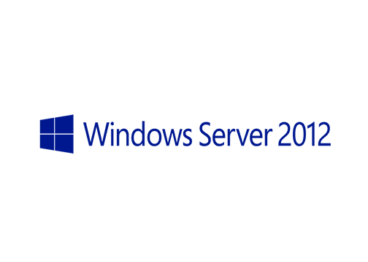
MegaSeries
Configure DNSSEC

Slide 2
Steps
Create a new DNS zone and create some A records in it
Sign the zone on one of the domain controllers (it will be the key master)
Wait for replication and check the zone on the other domain controller server
Replicate the trust anchors and wait for the zone to be signed on the other DC
Create a NRTP rule and assign it to a client. Test that it validates the DNS records

Slide 3
Signing details
When signing you can use default settings, use settings from another zone or specify the settings yourself
It is advisable to not check the box for trust anchor replication right away; if you still have 2008 R2 DNS servers that are also DCs do not do it!
All DNS servers get the unsigned zone over the network and sign it themselves
DNS updates are also sent unsigned

Slide 4
DNS clients
By default clients do not enforce the validation of a zone
Clients that support DNSSEC start from Windows7/Windows Server 2008 R2
NRPT rules can be applied to clients to force the validation of namespaces (DNS zones)

Slide 5
https://www.youtube.com/channel/UCcZ-jLbPwNr8E_v9-65n8Iw https://github.com/itknowledge4

